Slide 1


A Brief History of My Experiences as a Scientist on Social Media
Dr. Joshua R. Herr
Department of Plant Pathology
Center for Plant Science Innovation
University of Nebraska – Lincoln
@number_three
joshuaherr.com / herrlab.com
June 28th, 2018

Slide 2
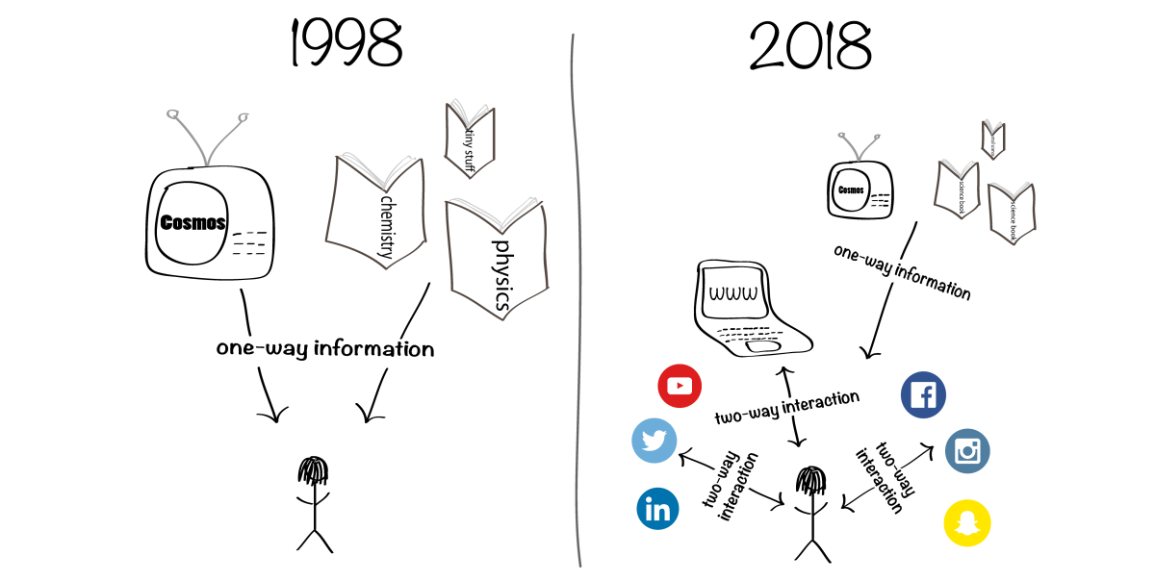
From: scicomm.org

Slide 3
Blogging – my first foray into science communication
Blogging from 2005-2015 (cymeandcystidium.com)
PROS:
Honed my writing skills
Kept me up to speed with new research
Broadened awareness of me and my research
Writing “spark”
High content of visuals with longer writing
CONS:
Time consuming
Costly
Blogging platforms and hosts kept changing
Getting hacked
Overwhelming feeling like no one was reading

Slide 4
Twitter (micro-blogging) my second foray into science communication
Tweeting from 2009-current (@number_three)
PROS:
Helps keep me short and to the point
Keeps me up to speed with new research
Broadened awareness of me and my research
Focus on visual content and “deliverables”
CONS:
Time consuming
Overwhelming
Overwhelming feeling like people think I should be using my time more efficiently
Overwhelming feeling like no one was reading
Overwhelming feeling like everyone is more productive than I am

Slide 5
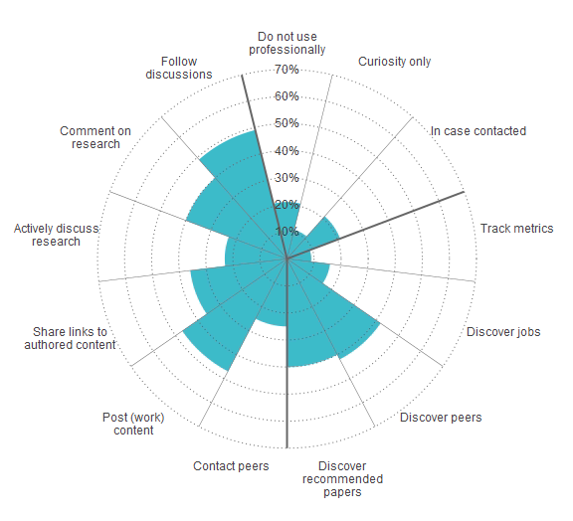
Why Academics Use Twitter?
Van Noorden 2014 Nature

Slide 6
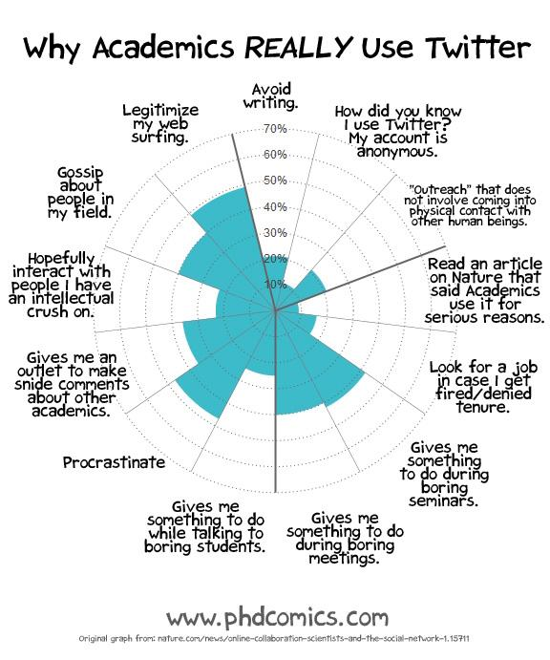

Slide 7
Why Do I Use Twitter?
The number one way I find out about literature now (not search for…)
News (Breaking News!)
Keep up to speed with activities at UNL
Follow and interact with other scientists
Follow and interact with citizen scientists and the general public
Remember information (bookmarking?)

Slide 8
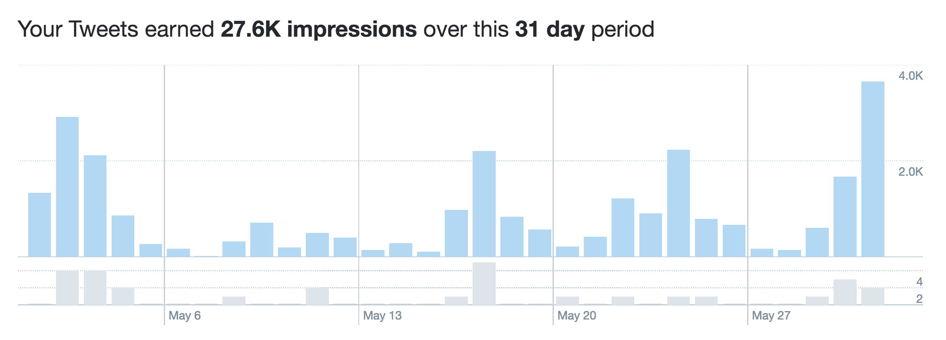
Tweet Views Across a Month

Slide 9
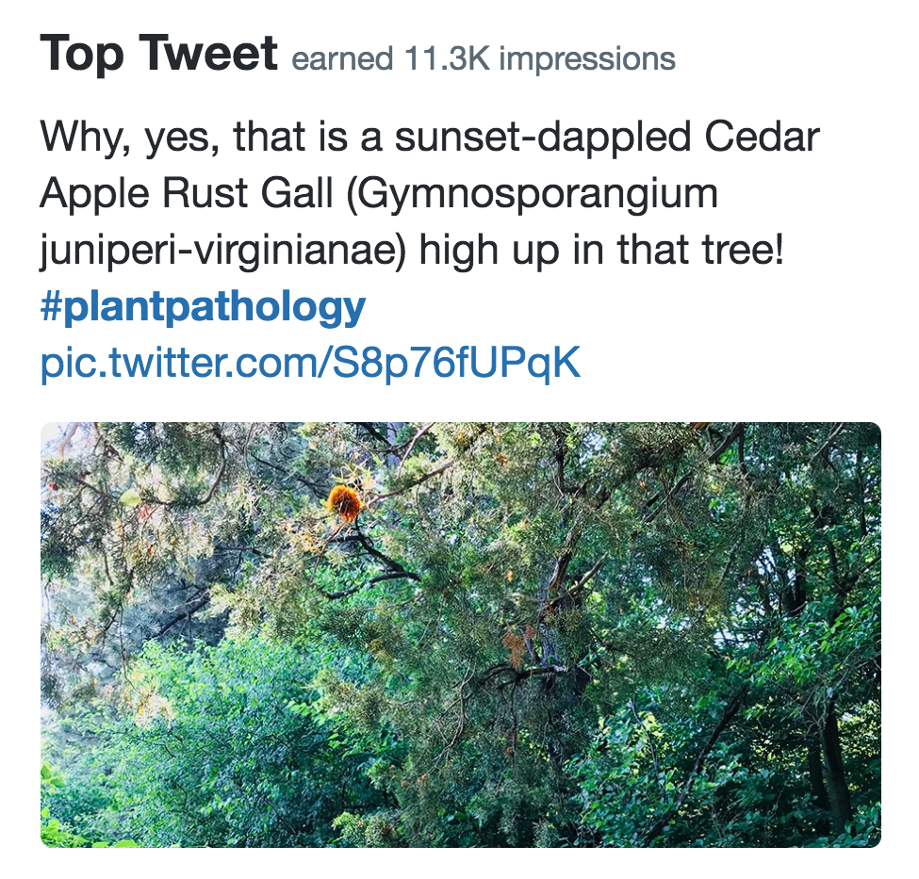

Slide 10
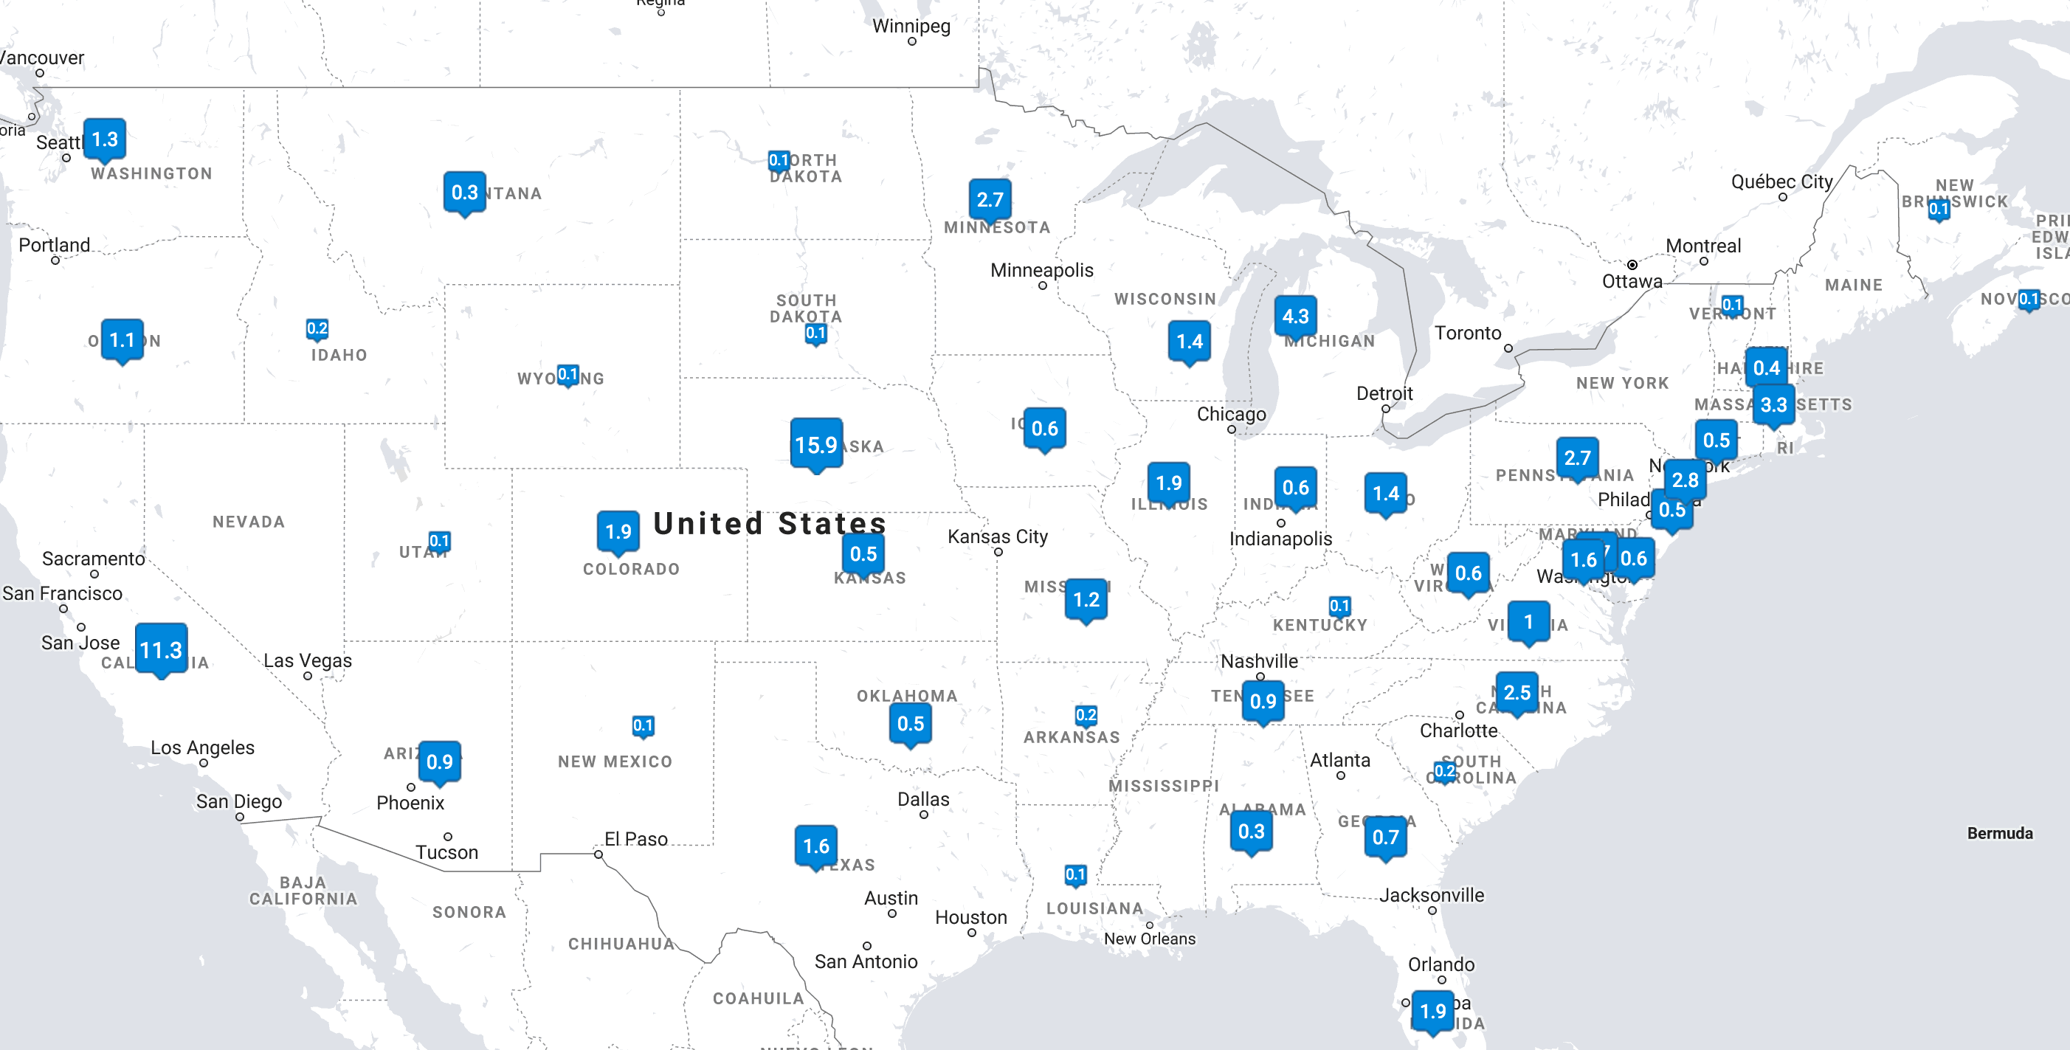
Where Do the Tweets Go?

Slide 11
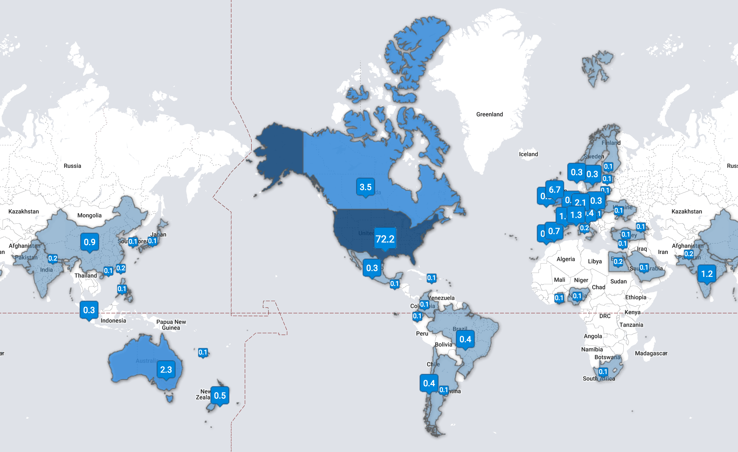
Where Else Do the Tweets Go?

Slide 12
Consequences of Twitter
NSF Program Manager to me via email (paraphrased):
“Hi. I follow you on Twitter. I appreciate your expertise. Would you be willing to provide an ad hoc review of some grants?”

Slide 13
Consequences of Twitter
Journal Editor to me via email (paraphrased):
“Hi. I follow you on Twitter. I appreciate your expertise. Would you be willing to provide a minireview or commentary for our journal special issue?”

Slide 14
Consequences of Twitter
Potential PhD Student to me via email (paraphrased):
“Hi. I follow you on Twitter. I would like to work with you. Are you currently accepting students?”

Slide 15
Consequences of Twitter
Faculty member from another institution to me via email (paraphrased):
“Hi. I follow you on Twitter. I was wondering if you would like to come give a departmental seminar at our university?”

Slide 16
Consequences of Twitter
Cool scientist to me in person at a conference (paraphrased):
“Hi. I follow you on Twitter. Do you want to get a coffee and talk about this grant I want you to be involved in?”

Slide 17
Consequences of Twitter
Promotion & Tenure Committee member to me via email (paraphrased):
“Hi. Among other things, the committee thinks the time you spend on social media could be better spent doing research.
By the way, I liked that one tweet about my graduate student’s work from way back.”

Slide 18
My Advice for Using Twitter
Don’t Try to Read Every Tweet (8000 every second!)
Try to Add Content (photos, video) or Links to Information
Drive Traffic to Your Sites and Those of Others (Publications, Websites, etc.)
Don’t be Afraid to Interact
Know Your Followers and Strike the “Right” Balance.
Use a Tweet Manager if it Helps (I use TweetDeck)
Use #hashtags, @mentions, and links intelligently

Slide 19
Questions?
Please follow me at:
@number_three
joshuaherr.com
herrlab.com

